Slide 1
Session 2: Further R
More dplyr
Intro to “Data Science”
Basic Data Visualisation in ggplot2
Basic Data Management

Slide 2
Recap last time
<-
install.packages
library
c()
print()
[], $, ==, <, >
as.numeric(), as.integer(), as.character(), as.date(), as.POSIXct() etc
rnorm, mean, mode, median, sd, sum
sort()
length()
str_sort()
str_length()
tolower(), toupper()
tibble()
%>%
list()
merge()
reduce()
full_join()
order()
mutate()
filter()
group_by()
nest()

Slide 3
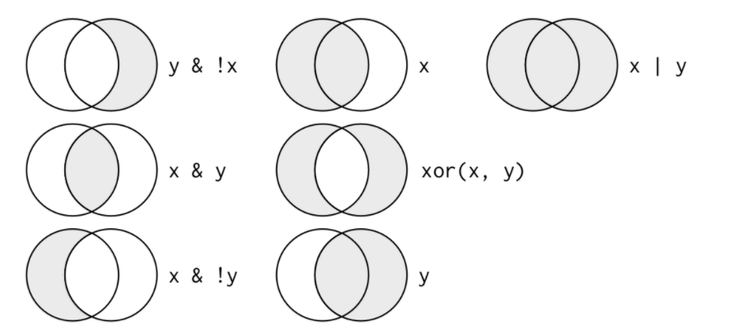
Boolean Operators

Slide 4
TIDY DATASET RULES
Each variable must have its own column.
Each observation must have its own row.
Each value must have its own cell.
Use gather() to change data into this format
Forget what you learned in secondary school about making tables

Slide 5
Arrange and summarise
dplyr::arrange() arranges rows by variables in ascending order
You can use the option , .by_group = TRUE to first sort by the grouping variable
This function ignores groups otherwise
Wrap your variable in desc(VAR) to arrange in descending order
dplyr::summarise() reduces groups to a single row return with the information you want summarised
na.rm = TRUE is an option you should use because otherwise any missing values will invalidate the entire summary as NA (na removal = true)
E.g summarise(mean_Hb = mean(Hb), na.rm = TRUE)

Slide 6
Practice
df used: test_df, anaemic_pts
Arrange your test_df by Hb, using both the bare function and the pipe operator to practice.
Arrange by group and .by_group = FALSE
Summarise the mean Hb for each grouped ward using anaemic_pts

Slide 7
Select and Rename
Often dealing with medical data you’ll have much more data than you need, with far too many redundant variables.
Select the tidy dataset you want to work with using select(df, var)
You can also match the variables you want using starts_with(), contains(), ends_with()
rename() is also a variant of select which doesn’t drop every other variable, and can be useful to know what you’re dealing with in your preferred naming style.

Slide 8
Practice
Select just ID and all variables which contain Hb from test_df and assign to new object
In this object rename ID as RSCH_ID
Do this in one piped command

Slide 9
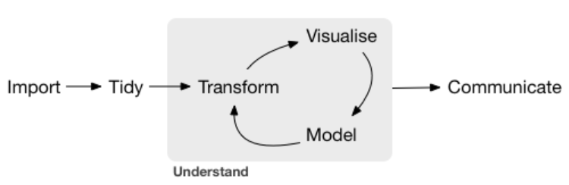
Data Science

Slide 10
ggplot2 and basic data visualisation
Implements a unified ‘grammar of graphics’ described in the paper I sent out (if you can be bothered to read it)
In the most basic usage visualisation can help inform ideas about relationships between two variables, often exposures and outcomes in epidemiology
Here is the basic code to make graphs with ggplot and the ‘Cheat Sheet’
ggplot(data = <DATA>) +
<GEOM_FUNCTION>(mapping = aes(<MAPPINGS>))

Slide 11














Your first ggplot
Use Hb_table and plot ID against Hb using geom_point()
ggplot(data = <DATA>) +
<GEOM_FUNCTION>(mapping = aes(<MAPPINGS>))

Slide 12
Practice
Let’s work with a real dataset
Save the csv file in your working directory and import the dataset into R using read.csv(“hospital_in_out.csv”)
Fix the new_date variable with this code
hospital_occupancy$new_date <- as.POSIXct(hospital_occupancy$new_date, tz = "", "%d/%m/%Y %H:%M")
Filter the dataset to new_date values higher than 1/1/2020 (hint, use as.POSIXcT and 01/01/20 00:00, tz = “”)
Select new_date, COVID, and any hospital specialties that interest you into a new df

Slide 13
Practice 2
Time to make your second plot, a geom_line
ggplot(data = <DATA>) +
<GEOM_FUNCTION>(mapping = aes(<MAPPINGS>))
Data = your new df
Geom_Function = geom_line
X = new_date, y = COVID
Now add a geom_smooth on top of it.

Slide 14
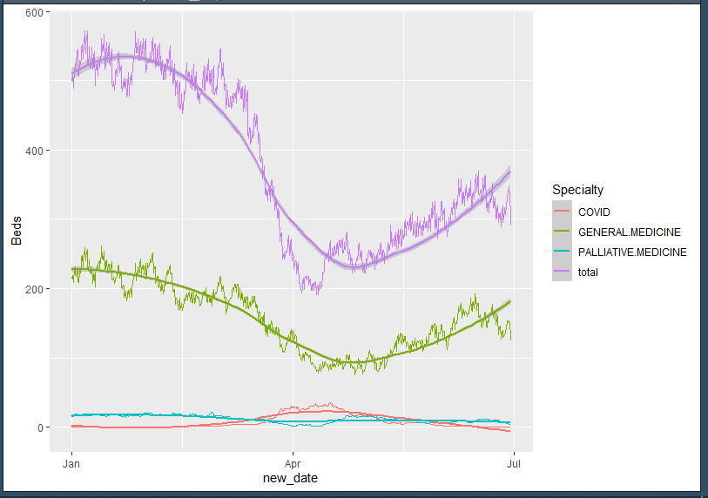
Multi-line drifting
Convert your new df into long data using gather
Long_df <- gather(df, key = Specialty, value = Beds, -new_date)
Now set the aes for the whole chart inside the initial ggplot() command (colour = Specialty is used to separate the lines)
Now try just adding geom_line() and geom_smooth() with no aes
Because you set the aes in the initial ggplot command it just follows those instructions.
Lots of customisation available.

Slide 15
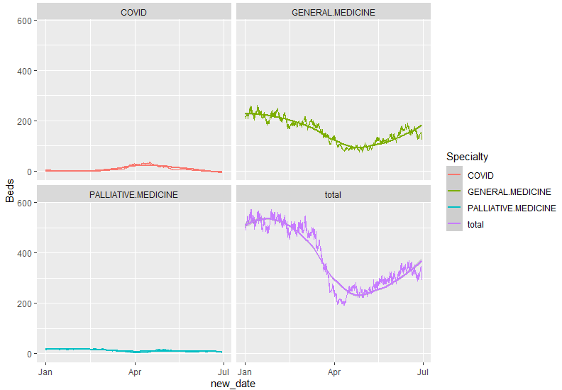
Further Data Visualisation
You can split these into multiple graphs with facet_wrap(~Specialty, nrow = 2)
Everything else can be taken from the cheat sheet or googled
If things don’t work go back to basics and check the str of your data
Try using geom_bar with the anaemic_pts df
For doing frequency bar graphs you don’t need to specify a y aes

Slide 16
Exploratory Data Analysis - warnings
EDA = Question -> Visualise -> New Question
Not always that simple in epidemiology
Correlation != Causation
When constructing a model be careful not to be blinded by the data, always keep in mind whether you’re forming a prediction model or a causal model.
Relevant variables are not always the ones most strongly associated with exposure and outcome.
Be very careful about how your model makes certain assumptions about relationships between different variables

Slide 17
Good Data Management Practice
Again: always use a script and a master copy of data, stored in multiple places and backed up regularly
Think carefully about your WD and how that can be used by someone on a different computer
Communication of results is important;
Only plot your key points, and make them easy to understand
Keep variable names out of formal presentations and relabel them in ggplot2 to be more understandable to your audience

Slide 18
Next Time
Statistical tests for numeric and binary outcomes
When to use certain measures of effect, and what are they really?
Basic stats maths
Basic introduction to confounding and Mantel-Haentzel Adjustment
Causal models or predictive models?

